Slide 1

By Owen, Eliska, Filip, Constanza & Vasco

Slide 2

Project Overview
Original data
Quite large and unorganized dataset about shark attacks related data, which included demographic and geographic informations, types of injuries and shark species.
Our goal
To clean the dataset and then analyse, in order to test our hypothesis.
Business Case
Educational and safety apps for ocean-goers to reduce shark incidents by providing real-time safety tips, risk factors, and location-based guidelines.
Hypothesis
Educating users about shark encounter risk factors, including location, time of year, and activity type, will increase their awareness and reduce shark-related incidents.

Slide 3
Data Wrangling & Cleaning
Techniques Utilized
To effectively clean and process the data, we applied various techniques and methods, including .apply, .map, .replace, .dropna, .isna, str.replace, .to_datetime, and .fillna.
We saved these cleaning processes as functions, so that they could all be called directly after the data is imported to then allow analysis.
Challenges Encountered
High volume of missing values and empty columns.
Determining the optimal approach to implement changes without disrupting the integrity of the database.
Inconsistencies in value names across columns and standardizing them for uniformity.
This approach ensured effective data cleaning, preserving database quality and accuracy.

Slide 4
Exploratory Data Analysis
Summary of data
After cleaning we had 4,454 incidents, ranging from 1900-2024, including the following columns:
Date, Year, Month, Season, Country, Hemisphere, Activity, Sex, Age, Fatal
Techniques Utilized
Functions groupby(), .agg(), .pivot_table(), for grouping data, unstack(), .melt(), sort_values() to prepare them for visualization
Seaborn and matplotlib.pyplot libraries, barplot and histplots for data visualization

Slide 5
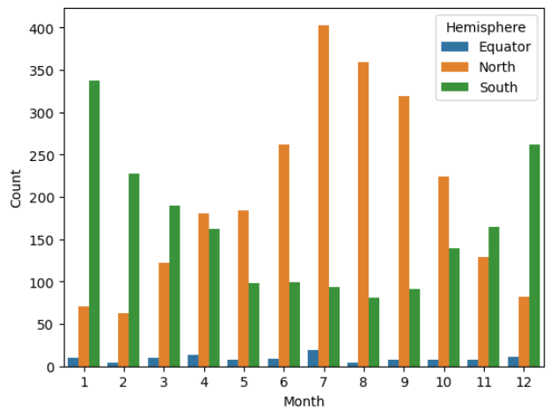
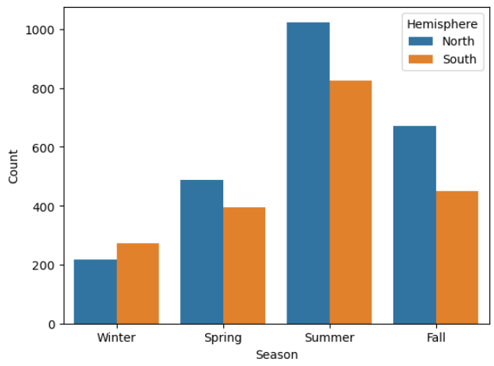
Exploratory Data Analysis
We observed trends in reported shark incidents by month across the two hemispheres.
In the Northern Hemisphere, most attacks occur from June-Sept, while in the Southern Hemisphere, the peak months are Nov-Feb.
This shows that warmer months see more incidents, likely because more people are in the water. It may also indicate that sharks are more active in warmer conditions.

Slide 6
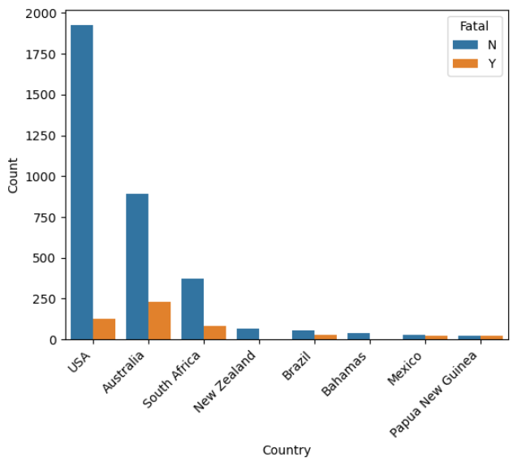
Exploratory Data Analysis
The US had by far the most reported incidents of any country, although Australia had a higher number of fatal incidents.
This suggests that the sharks around Australia are far more dangerous than the ones found in America, as despite Australia’s far smaller population they have a high count of shark fatalities.
We also observed a significant decline in the percentage of fatal shark attacks, dropping from over 60% in the early 1900s to around 5.66% in the 2010s, this trend could be due to improved medical response, increased public awareness, but also because of more accurate data

Slide 7
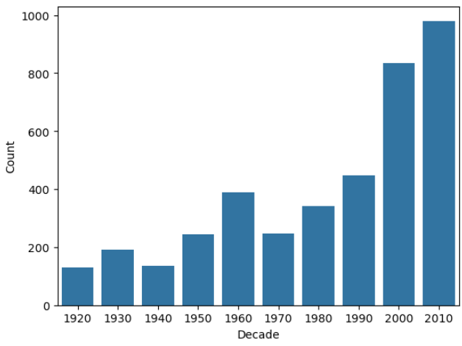
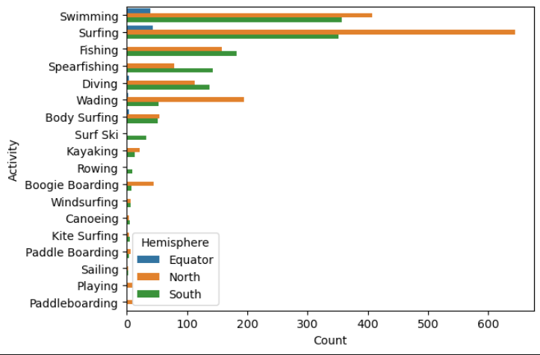
Exploratory Data Analysis
The reported number of shark attacks has significantly increased over the last 100 years.
However, this is likely due to increased reporting and increased global population.
Most shark attacks occur when people are either Swimming or Surfing.
These are more dangerous than activities such as being on a boat, or fishing, where you can be out of the water

Slide 8
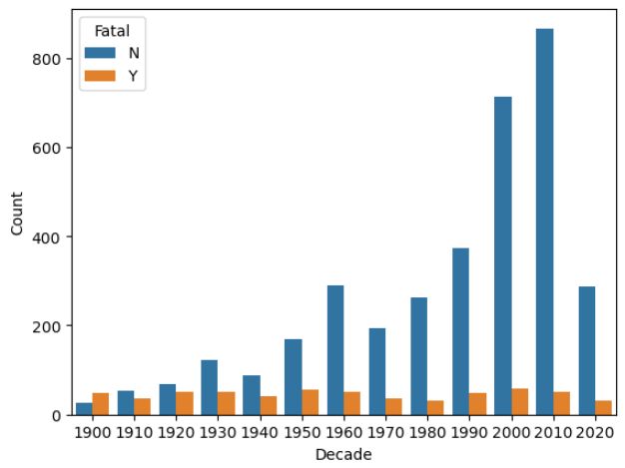
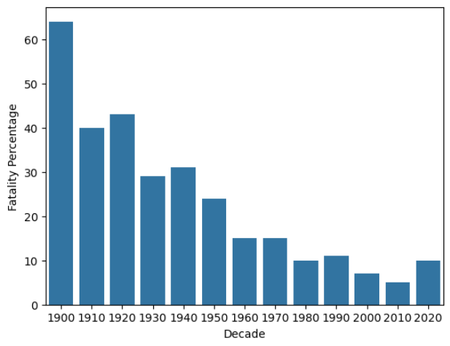
Exploratory Data Analysis
Whilst the number of reported incidents has significantly increased, these are now mostly non-fatal. The level of fatal incidents has remained fairly consistent by decade.
Therefore, the proportion of fatal incidents has significantly reduced.
This could be due to improved medical response, increased public awareness, and increased reporting of non-fatal incidents

Slide 9
Major Obstacle
Learnings
Missing Data
Duplicate Data
Inconsistent Values, requiring standardization for accurate analysis.
Working on the Git Hub (how to use it properly) and Colab.
Learn to identify and remove duplicate entries for accurate representation.
How to develop techniques to handle missing values, such as removing incomplete rows and make data easier to analyze and group, enhancing accuracy.
Gain skills in version control and collaborative tools for managing project changes
How good project planning and tasks dividing can help to finish project on time without any pressure
Overcoming these obstacles helped us to improve data quality, analytical accuracy, and team collaboration, leading to a more professional and reliable project.

Slide 10
Conclusion & Insights
Surprising findings
Most shark attacks occurred during warmer months in each hemisphere.
Surfing and Swimming are at the top of the most dangerous activities.
While USA has the most shark attack incidents, Australia has the most fatal incidents recorded.
Significant decline in the recorded percentage of fatal shark attacks, dropping from over 60% in the early 1900s to around 5.66% in the 2010
Potential implications of findings
People need to take care of sharks, especially if in more dangerous locations, seasons and countries. Especially Australia in Summer, when swimming or surfing

Slide 11
Thank you!
and don't let the sharks get you

